Slide 1
Where to open an Italian restaurant in Manhattan?

Slide 2
Executive summary
This project will look into the best neighbourhood in Manhattan to open an Italian restaurant.
Assuming that the interest (or appetite if you will ☺) for an Italian restaurant is similar across Manhattan, and that this is a very popular type of restaurant, we’ll use the data from Foursquare regarding the proportion of different types of restaurants for each neighbourhood and try to identify areas where an Italian restaurant could be open without saturating the market.
First we’ll analyze the TOP10 types of restaurant/food place for each neighbourhood and we’ll focus on those areas where Italian restaurants are not in the TOP10.
Results will show 2 potential areas (which are actually close to each other)

Slide 3
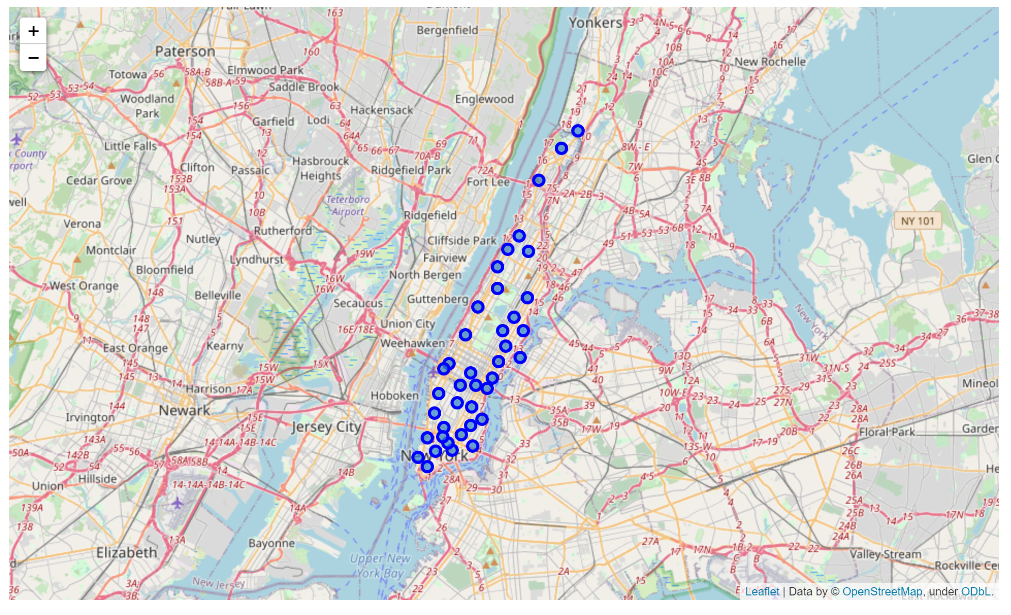
Manhattan neighbourhoods in the map

Slide 4

Top 10 most common restaurants / food places per neighbour-hood

Slide 5
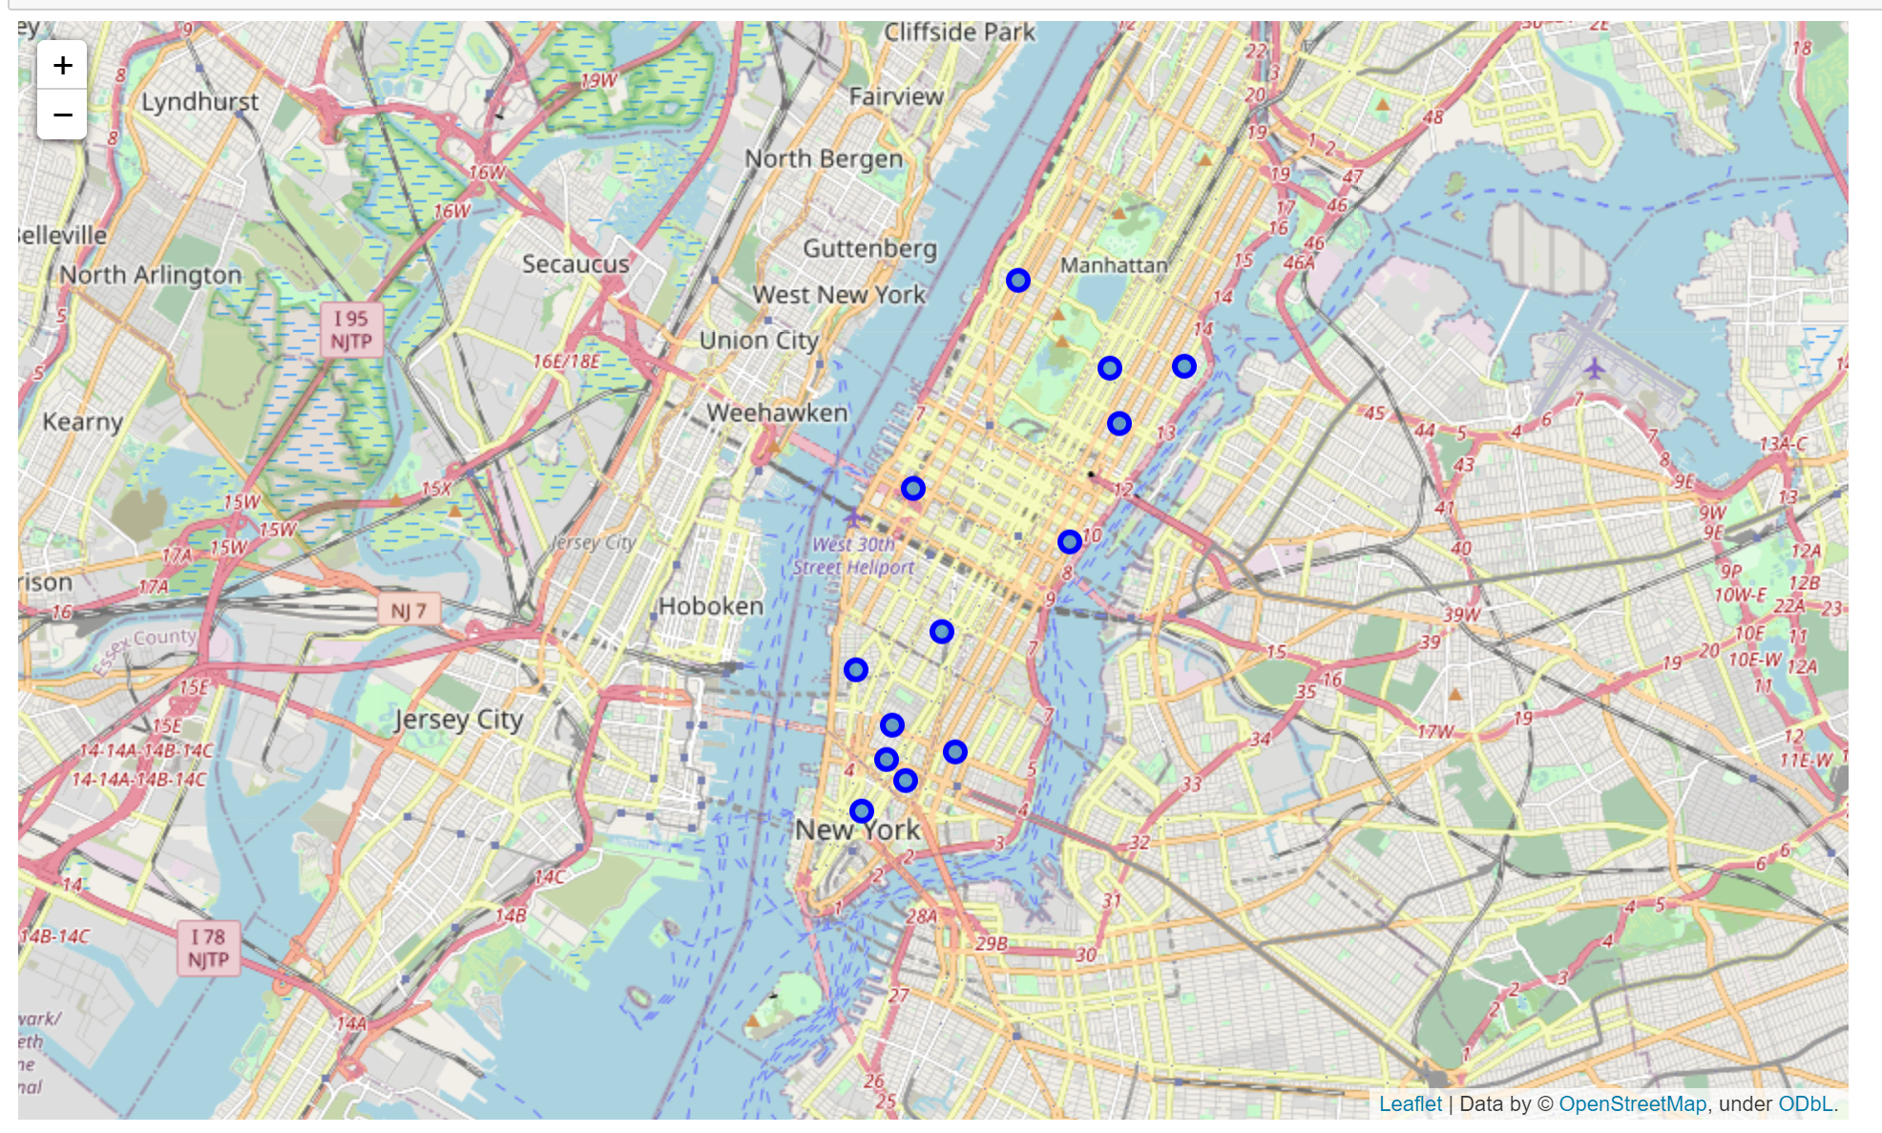
In 13 neighbourhoods (out of 40), Italian restaurants are the most common restaurant type

Slide 6
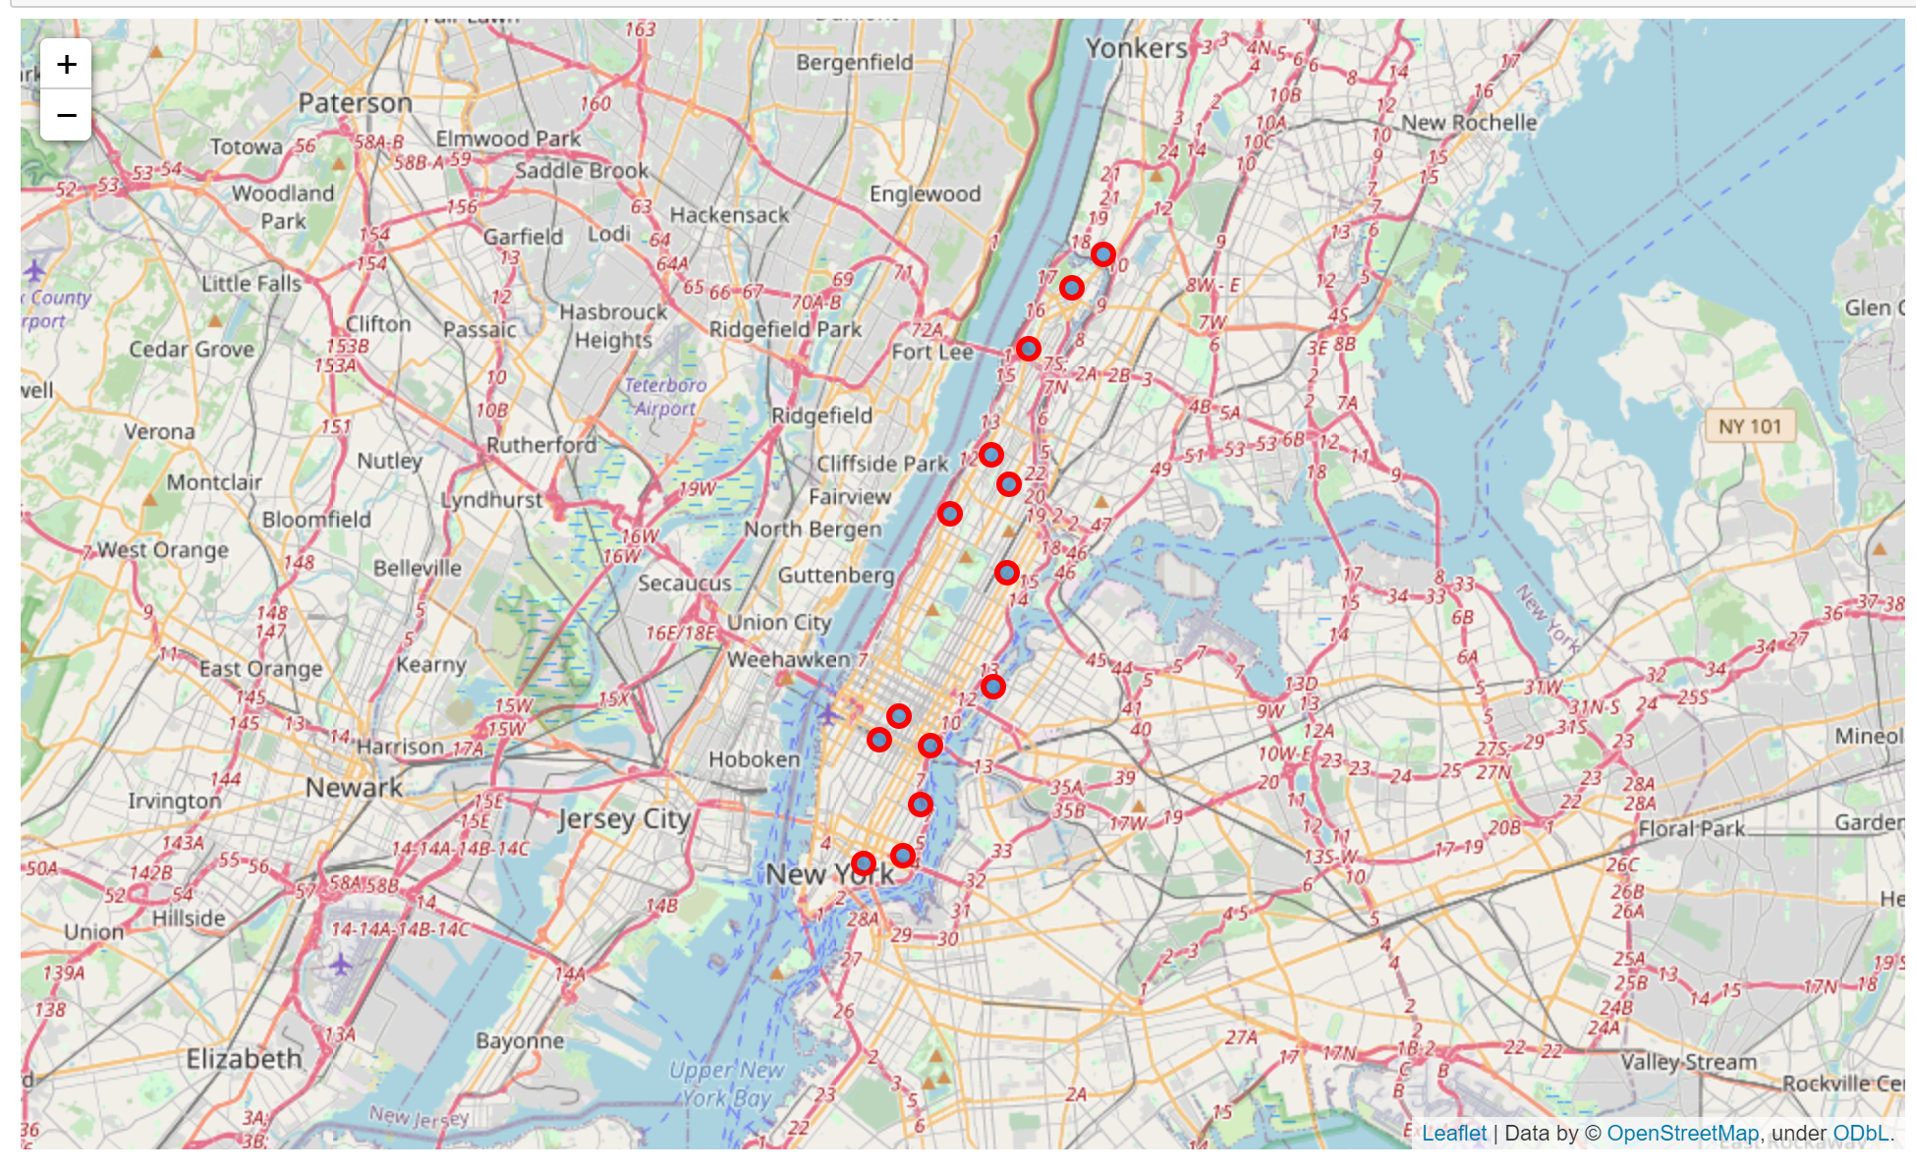
While in 14 neighbourhoods, Italian restaurants do not appear in the TOP10

Slide 7
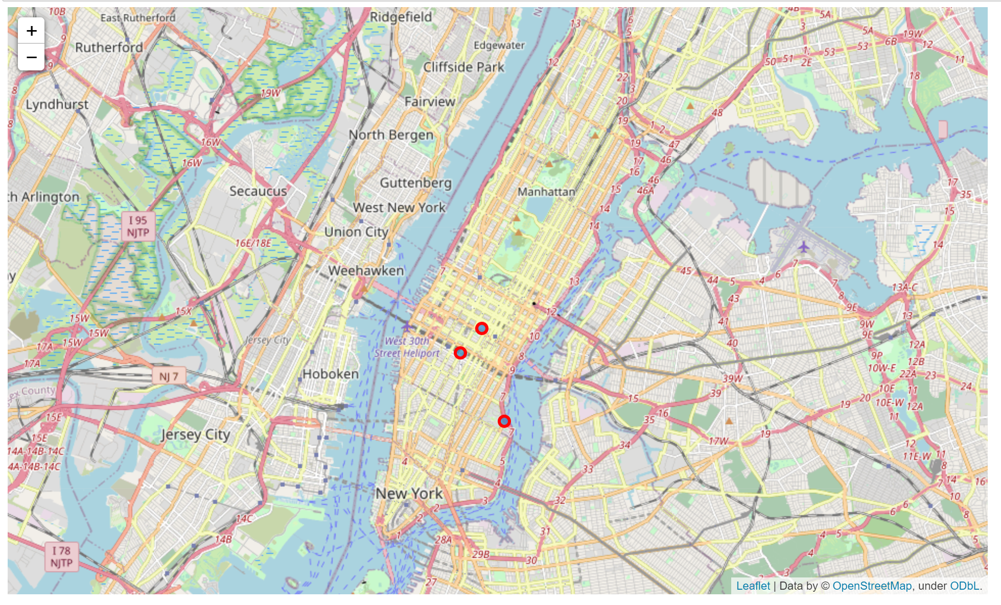
Looking at these 14 neighbourhoods, most of them still have “pizza place” in the TOP10, so if we remove those, we reach 3 areas, as below
CONCLUSION:
Knowing that the neighbourhood of Stuyvesant Town (bottom right) only got 5 restaurants in Foursquare (showing a potential lack of demand), the neighbourhoods of Midtown and Midtown South look the most attractive to open an Italian restaurant in Manhattan

